Slide 1
Community College Skills Webinar Series Partnering for New Collar Success
November 2017

Slide 2
Welcome and Introduction IBM’s Commitment to New Collar Overview of New Collar Programs Public Partnerships Digital Badging Q&A

Slide 3
IBM's Commitment to New Collar Joanna Daly VP, Talent

Slide 4
Overview of New Collar Programs Kelli Jordan Talent Leader, New Collar Initiatives

Slide 5
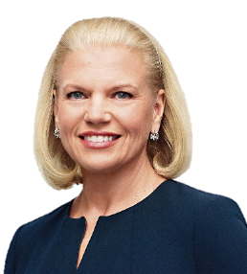


We have an opportunity to lead the industry in creating new ways to solve the skills gap
The market:
The opportunity:
Let’s work together to scale up this approach of vocational training, creating a national corps of skilled workers trained to take the “new collar” IT jobs that are in demand here in America.
51%
Industry executives citing finding appropriately skilled workers in local labor markets as the greatest challenge related to skills
~ Ginni Rometty
Letter to President-Elect Trump
November 2016
The solutions:
71%
Lead the industry with the development of a best-in-class apprenticeship program focused on identifying and training new collar talent for key technical roles
Build an integrated program targeted to community colleges that provides faculty and staff access to IBM offerings, education, and programs which will allow students and participants to build the skills needed for new collar roles
Build new pipelines to employment through new partnerships with P-TECH, community colleges, and veterans programs
Corporate recruiters that indicated they cannot find applicants with sufficient practical experience

Slide 6
IBM Apprentice Program Overview
October 2017
Received approval from United States Department of Labor
First three roles
Software Engineer
Junior Associate Project Manager
Mainframe System Administrator
Competency-based
Varies in duration (12 – 18 months)
Deploying at locations across the US
Coordination with Community College partners and local workforce boards
Ongoing validation of competency attainment, learning completions, apprenticeship progression
Roles in development
Lab Technician (3 tracks)
Electronics Technician (3 tracks)
Data Analyst
Talent Acquisition

Slide 7


New recruiting models and programs can help drive new collar hiring
IBM played a key role in developing the P-TECH 9-14 School Model (Pathways in Technology Early College High Schools), a six-year, career-focused technical education model that combines high school and two-year post-secondary STEM (science, technology, engineering and math) degrees – along with the workplace curriculum, mentoring, and paid internships required to prepare students for success in college as well as new collar jobs.
Now, IBM is focused on developing internship opportunities for P-TECH students in their 4th year, and identifying full-time employment opportunities for graduating students.
As part of IBM’s commitment to hire more than 2,000 veterans over the next four years, we’re working to launch new programs, like our Military Fellowship program. This program provides transitioning service members with 12 weeks of on-site work experience at IBM, free of charge to IBM managers.
IBM’s Veterans Employment Initiative also continues to provide software training, certification and job placement assistance to veterans pursuing careers as data analysts.

Slide 8
Public Partnerships Stephen Dodd Certified Project Executive, IBM Public Partnerships

Slide 9
Workforce Incentive Programs
In today’s global economy, governments are constantly searching for ways to ensure their workers can compete in the evolving job market.
Aware of the trend that competitive employees have to possess the best and most advanced skills, government agencies have established multiple training grant programs to promote worker skills.
As a result of the productivity of a highly trained workforce, states are able to boost their own economies by retaining jobs within their borders. The ensuing benefits of worker investment have been well documented. In California, independent research has shown five dollars in earnings for an initial dollar invested in workforce training.

Slide 10
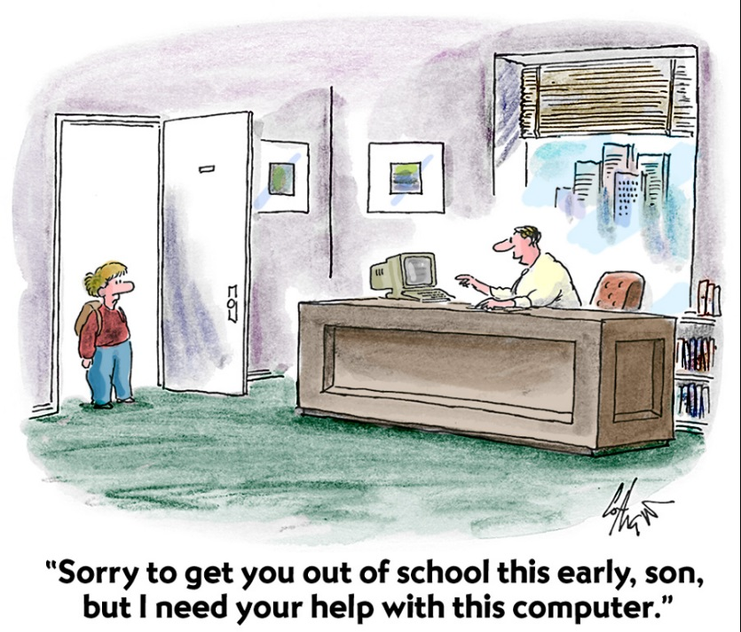
Workforce Incentive Programs
To recruit and retain business, governments offer workforce development incentives to companies.
As workforce development can be expensive for companies, incentives, particularly those addressing the cost of training and “up-skilling” of employees, have an impact on the business and investment decisions for many firms.
Governments are also aware that as workers increase their skills capacity, they are also contributing to innovation and product development.

Slide 11
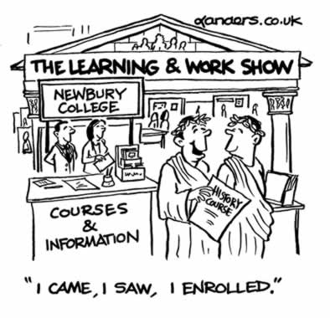
Workforce Incentive Programs
Most programs are direct financing incentives which reimburse cash for workforce training.
Grants are usually given for new or incumbent training and sometimes, a combination of both.
The programs are designed to respond to dynamic business trends by establishing multiple and/or rolling application periods along with prompt confirmation of a decision upon submission.
Grant programs are available at the Federal, State and Local government agencies and may be either discretionary or statutory in nature.

Slide 12
Workforce Incentive Programs – Future Funding & Partnership Opportunities
The Federal FY17 Appropriations Bill included the appropriation of $95m for the advancement and growth of apprenticeship programs – both Registered and Recognized.
About $100+m in H-1B user fee funds will also available for the advancement and growth of apprenticeship programs.
The $200+m will probably be allocated to directly to States, Request for Proposals (RFP) and grant funding opportunities.
These funding streams will provide an opportunity to form partnerships with Colleges, Workforce Boards, and Non-Governmental Agencies to assist in the growth advancement and growth of apprenticeship programs.

Slide 13
Digital Badging James Daniels Senior Program Executive, Innovation and Growth Initiatives

Slide 14

World leaders are telling us they have major challenges in finding workers with required skills
51%
Industry executives citing finding appropriately skilled workers in local labor markets as the greatest challenge related to skills
71%
Corporate recruiters that indicated they cannot find applicants with sufficient practical experience
Sources: Multiple. See notes.
Notes:
Sources:
Global Skills Study QI3 – What are your organization’s greatest challenges related to skills? n = 3,361
Pursuit of relevance: How higher education remains viable in today’s dynamic world. IBM Institute for Business Value. June 2015. 3. Q21 “What are your greatest challenges in recruiting the right candidates from higher education institutions?” n = 132
________________________
Additionally, according to Manpower’s 1015 Talent Shortage survey of over 41,700 employers in 42 countries and territories, 38% of employers report difficulty filling jobs – the highest proportion since 2007. (Source: 2015 Talent Shortage Survey. ManpowerGroup. http://www.manpowergroup.com/wps/wcm/connect/408f7067-ba9c-4c98-b0ec-dca74403a802/2015_Talent_Shortage_Survey-lo_res.pdf?MOD=AJPERES&ContentCache=NONE)

Slide 15

Changes in the labor market required us to change and rethink how we would meet the market demand for talent
+
+
Rapid Development
requires “liquid skills”
Shadow IT
decentralizes IT
Line of Business Jobs now require IT skills
+
+
Rise of Teams
require expertise location
Gig Economy
requires a skills registry
New collar jobs
require new credentials

Slide 16
EVERYTHING POINTED TO A
NEED TO
CHANGE THE WAY
WE DEVELOP AND TAKE INVENTORY OF
SKILLS

Slide 17




These signals required us to create a new credential structure to signal and surface capability:
Timely
Verifiable
Portable
Discoverable
Differentiating

Slide 18
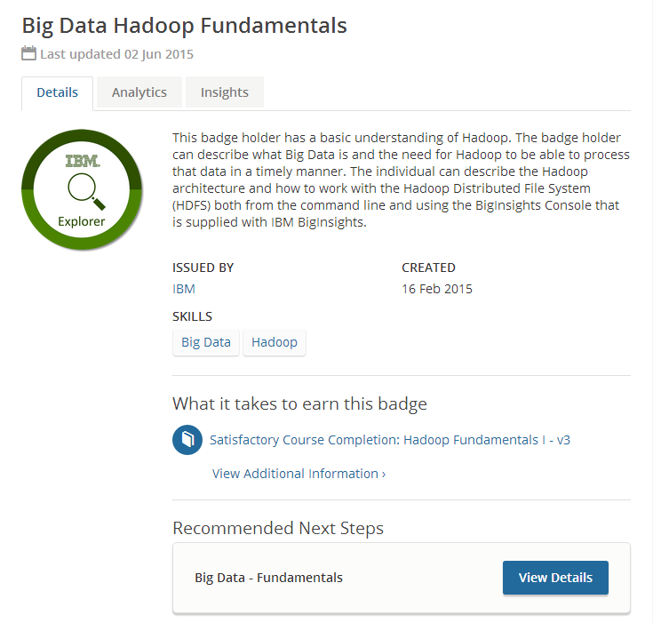
Open Badges seemed to fulfill all of our requirements
Digital emblem which provides timely symbol of skills and achievements
Analytics provide insight into how a program is performing
Contains metadata with skills tags and accomplishments
Easy to share in social media: LinkedIn, Twitter, FB, blogs
SHARE
Provides a progression path to advance commitment
Tethered to badge issuer to validate and verify achievement
Portable: Standards-based on Mozilla’s Open Badges standard

Slide 19
A pilot begins
(Is this going to work?)

Slide 20

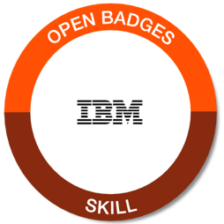
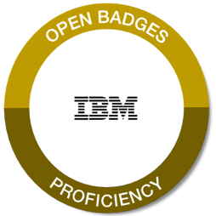
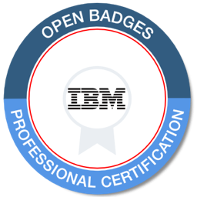

We developed five unique digital badges to encompass the broad activities we host at IBM
Knowledge | Skills | Proficiency | Certified | General
Badging is how we will measure resume-worthy IBM skills in the market

Slide 21










The results have exceeded our expectations
Engagement
Certifications
Product Trials
Employability
87% increase
57% increase
64% increase
92% say verifies job skills
Enrollments
Completions
Social Media
Skills Registry
125% increase
694% increase
$175K per 10,000 badges
191 countries
LinkedIn profiles with IBM badges receive 6x profile views.
Notes:
A quick study in one area of our business shows significant promise here. When certification test takers completed badge activities to prep them for the exam. The pass rates increased 58% versus the pass rate for those who did not earn those progression badges.

Slide 22
IBM Digital Badges are transforming every area of our business

Slide 23
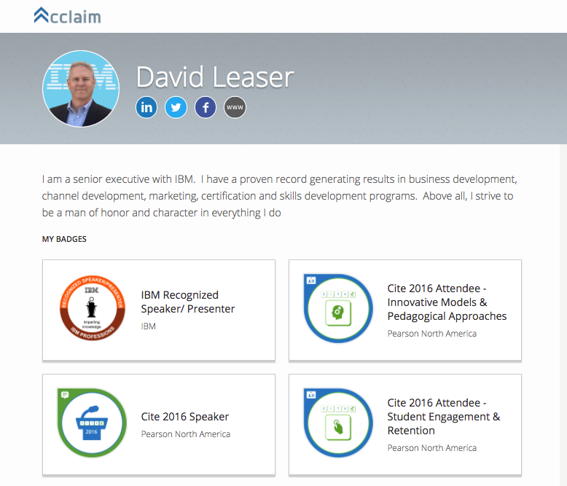
Digital badges automatically generate a digital resume with verified achievements . . . better than a paper resume?
Links to full social media profiles, like LinkedIn, Twitter and Facebook
Bio or statement gives a brief overview
Verified credentials can be double-clicked to see specific skills and links to evidence.

Slide 24
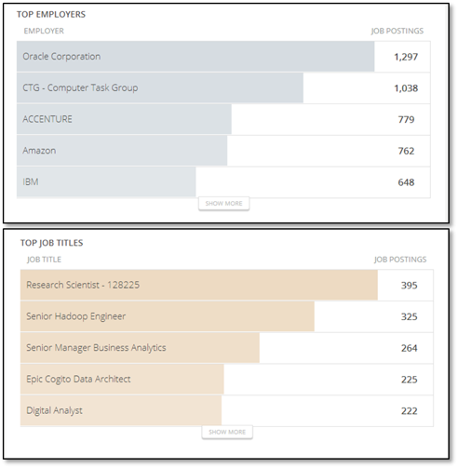
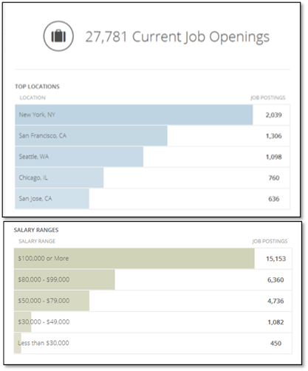
Every IBM Digital Badge is embedded with links to real-time dynamic labor market data – and actual job postings

Slide 25
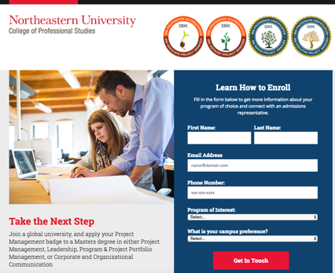
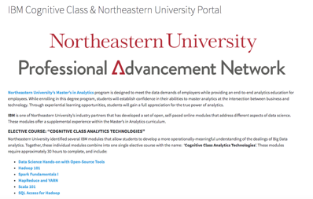
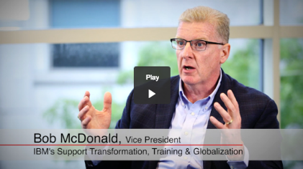
IBM Digital Badges now count for college credit at Northeastern University, a Tier 1 U.S. school
Because of IBM Digital Badges, we now have a common language and a verifiable credential mechanism to connect industry skills with institutional skills:
IBMers can receive college credit toward an online Master’s Degree for skills earned at work: http://ibm.biz/IBM-NEU-Project-Mgmt
IBM customers can also receive college credit through Cognitive Class toward a degree at Northeastern: https://cognitiveclass.ai/northeastern/
Forbes sees the IBM + Northeastern program as a sea-change and is planning to publish our story in September.
Prior learning not only benefits your professional career; it now had value in the market. With Digital badges, we can now translate those skills into prior learning credits.
Notes:
1) Northeastern recruiting page for IBM Project Management badge earners: http://ibm.biz/IBM-NEU-Project-Mgmt IBMers who have earned these badges will get prior learning credits from Northeastern. For example, an IBMer who has earned the IBM Executive
Project Manager badge will receive three courses or 10 quarter Hours in prior learning credits toward a degree at Northeastern.
2) Northeastern recruiting page for Cognitive Class badge earners: http://ibm.biz/ibm-neu-bdu Students who earn an average of 85% or higher in the ‘Cognitive Class Analytic Technologies’competency modules will be awarded with one elective course (totaling 3 credits) advanced standing within the MPS in Analytics program at Northeastern University and an expedited enrollment process.
3) Northeastern portal page for Cognitive Class. This is the page Northeastern points their own students to so they can take IBM courses and earn credit: https://cognitiveclass.ai/northeastern/

Slide 26


IBM’s digital credential strategy is influencing public policy
US Department of Labor, US Department of Education, US Chamber of Commerce have incorporated IBM’s strategy into their policy discussions.

Slide 27
Lessons learned

Slide 28
Through trial and error, we learned what works and what does not. Here are important takeaways:
Develop a solid communication plan with persuasive language.
Develop measures of success.
Badge what you have.
Provide strong benefits statements (marketing) into the intro letter to badge earner.
Keep it simple and flexible.
Add progression and engagement paths into every badge.
Metadata matters, from skills tags to links of evidence.
Names are important: Nobody wants a “newbie” badge.

Slide 29

Thank you!
Website: ibm.com/badging
Twitter: @danielsje
LinkedIn: https://www.linkedin.com/in/danielsje
IBM:danielsj@us.ibm.com

Slide 30
Q&A

Slide 31
Thank You! Website: www.ibm.com/jobs/us/newcollar/ccskills Email: ncollar@us.ibm.com Phone: 303-349-2788

